Slide 1

Medium-Fi Prototype

Slide 2
Strengthening democracy by empowering the next generation of voters.
Problem: Currently, political news outlets are not targeting young consumers. As a result, Gen Z feels lost, disillusioned, and cynical about politics. They are overwhelmed by the constant barrage of news that. They need a fun, accessible way to learn about policies and organize their views.
Solution: We propose a simple application that has features (social media memes, emojis, Tinder “swiping”) that make politics feel fun and young. Our solution helps young voters understand what policies matter to them and learn more about upcoming elections.

Slide 3
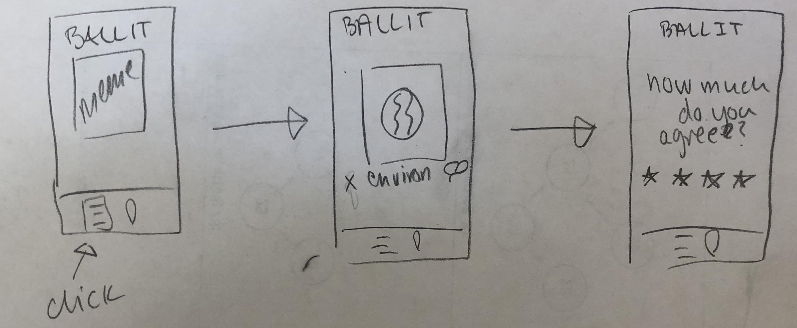

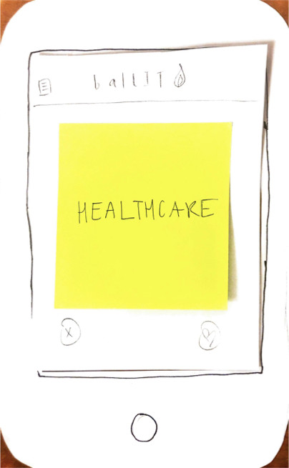
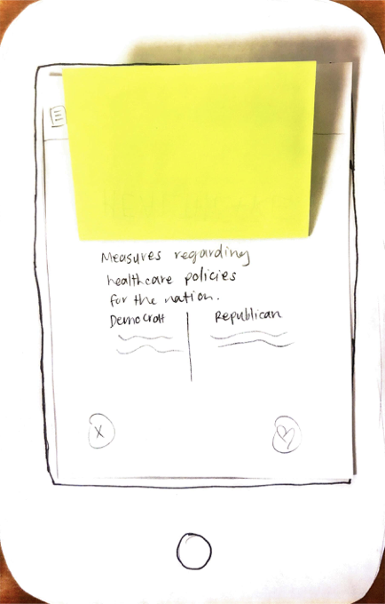
Task One (Simple)
Now: Find policies that you are interested in and discover your positionality on them.
Previous: Find policies that you are interested in.

Slide 4
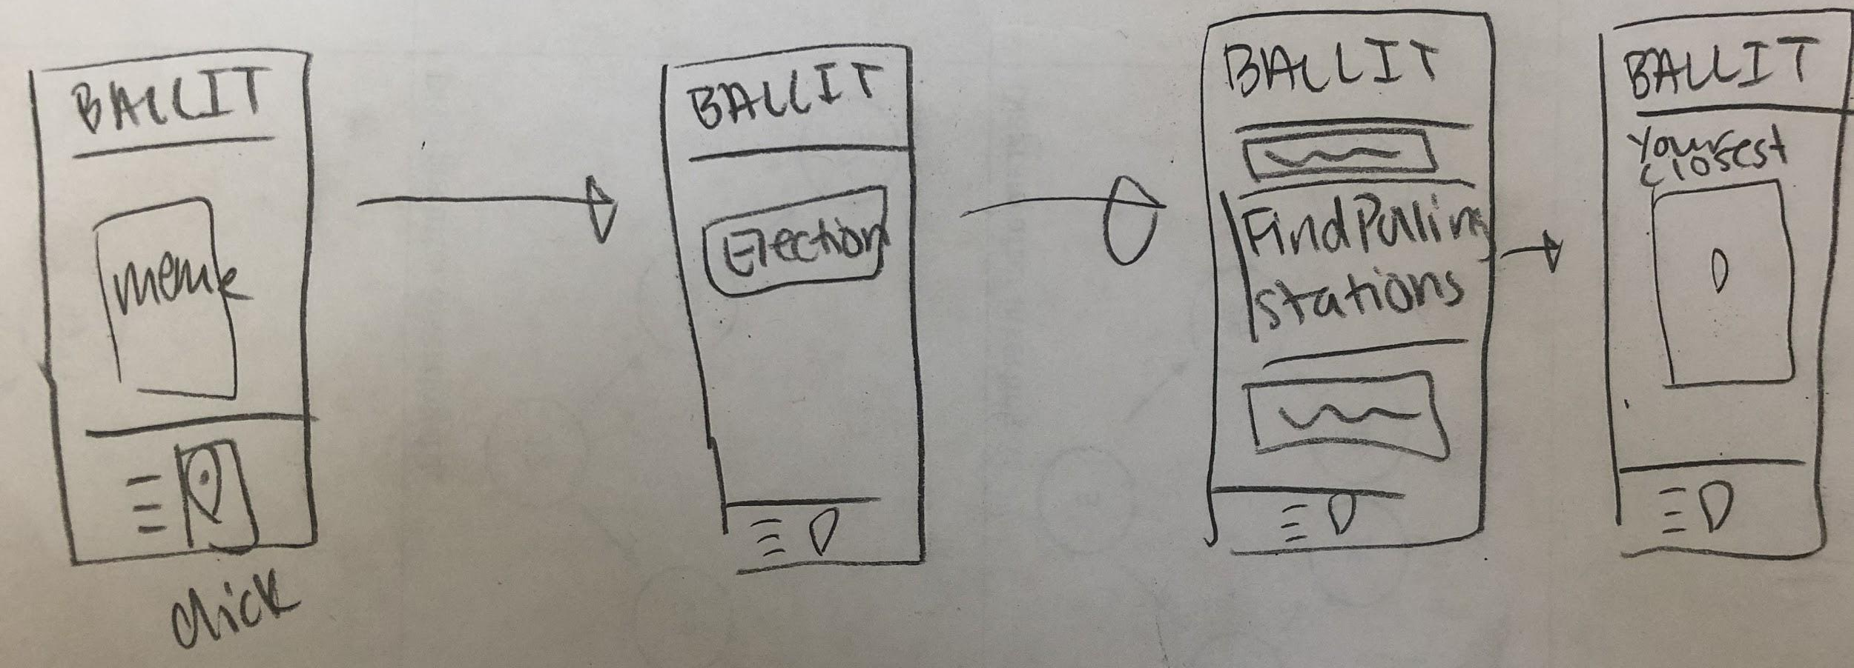
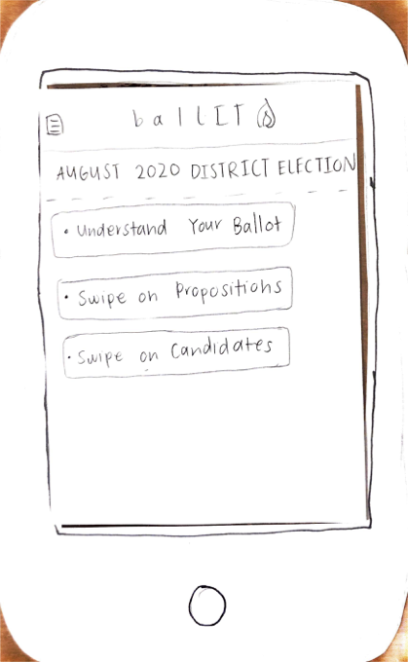
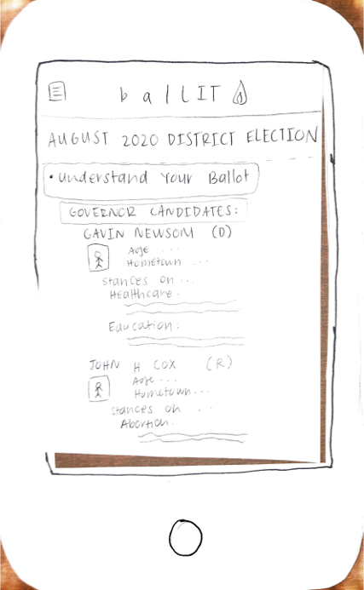
Task Two (Medium)
Now: Discover local elections and polling stations.
Previously: Discover candidates (this was wrapped into task three).

Slide 5
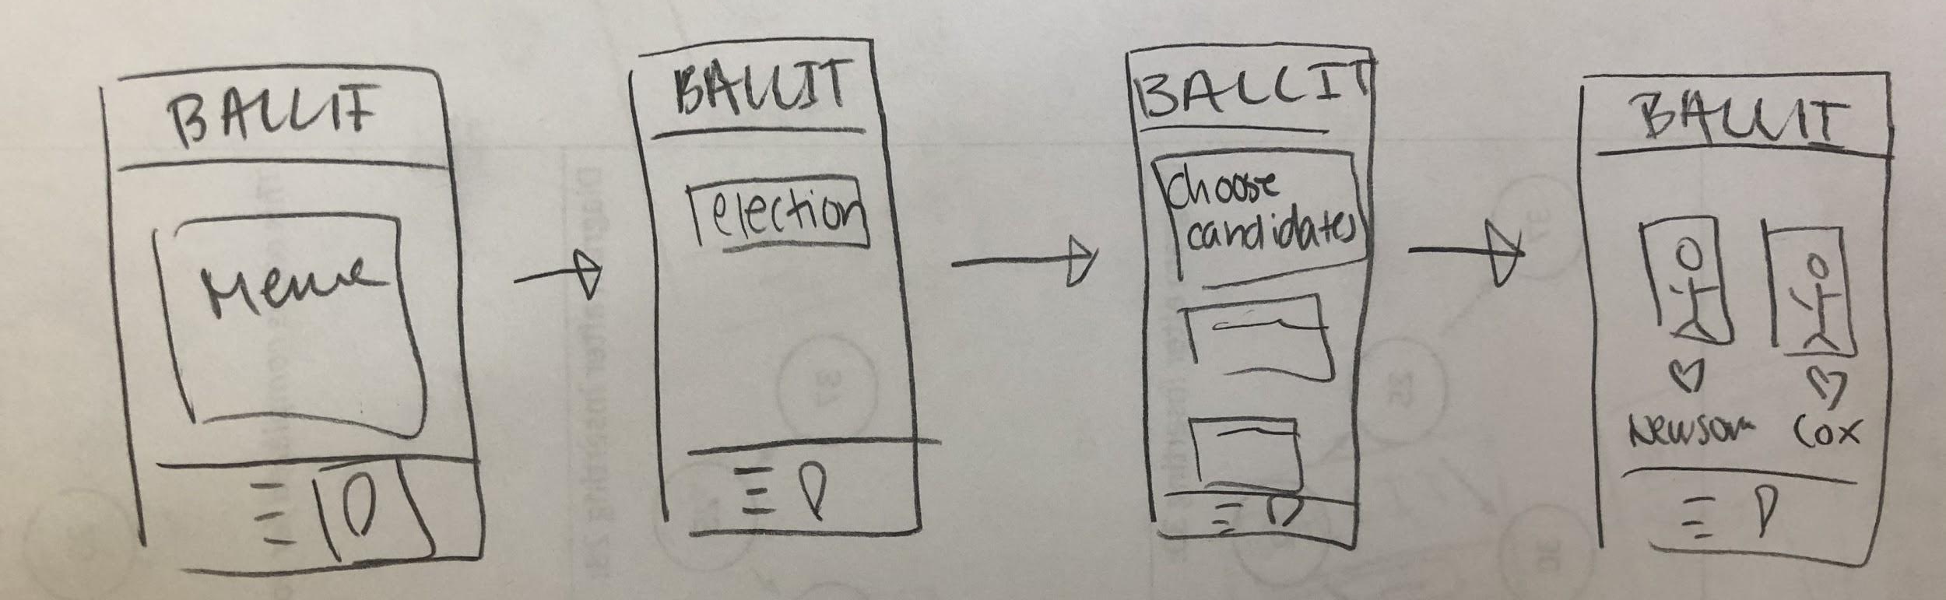
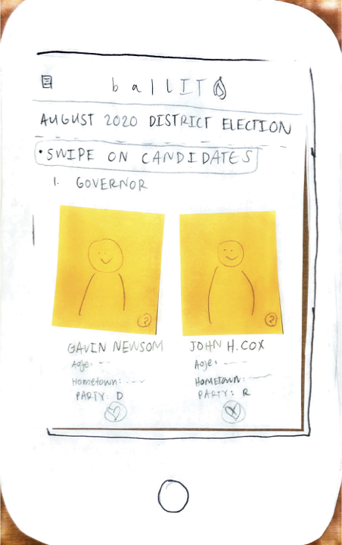
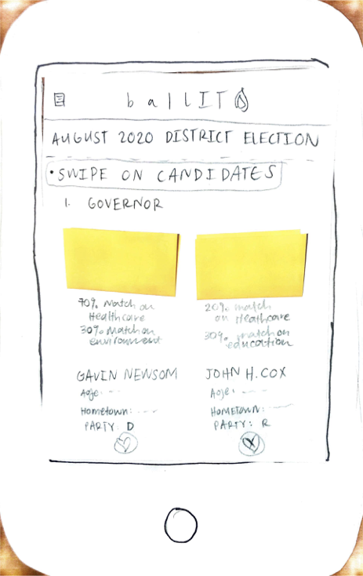
Task Three (Complex)
Now: Compare candidates running for each position by seeing how they match up with your policy preferences and then “liking” the one you think would be the best.
Previously: Compare candidates by swiping on each candidate running for each position.

Slide 6
Medium Fi Prototype

Slide 7
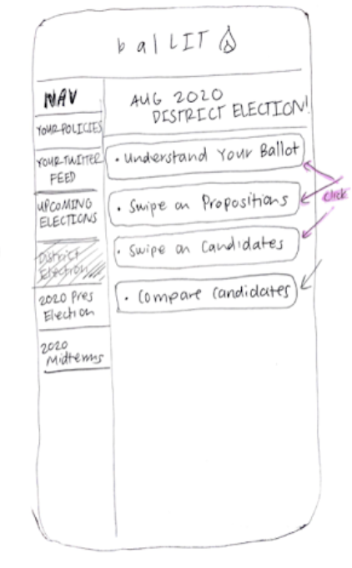
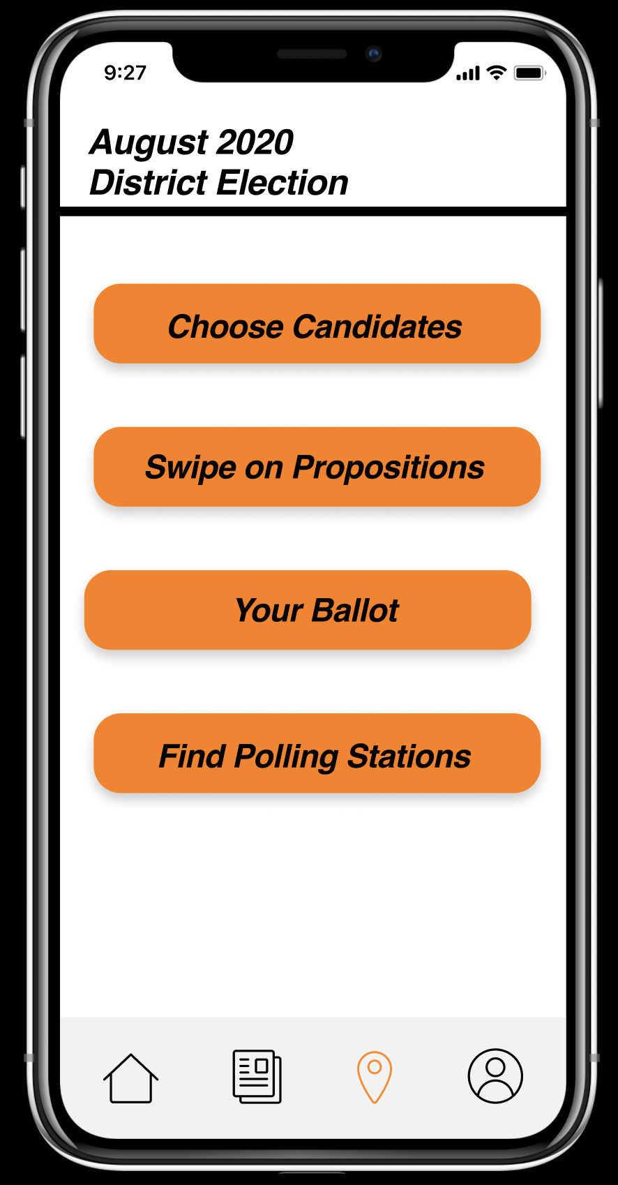
Major Design Change One: Navigation
Old navigation bar was confusing to navigate. Users commented that they felt overwhelmed by the options.
New design is simplified and intuitive - mimics the “home bars” of popular apps like Twitter and Instagram, which our users likely already use.

Slide 8
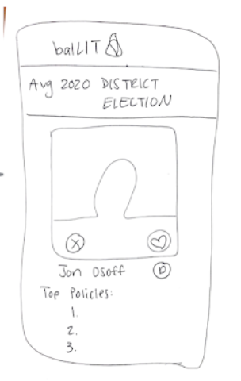
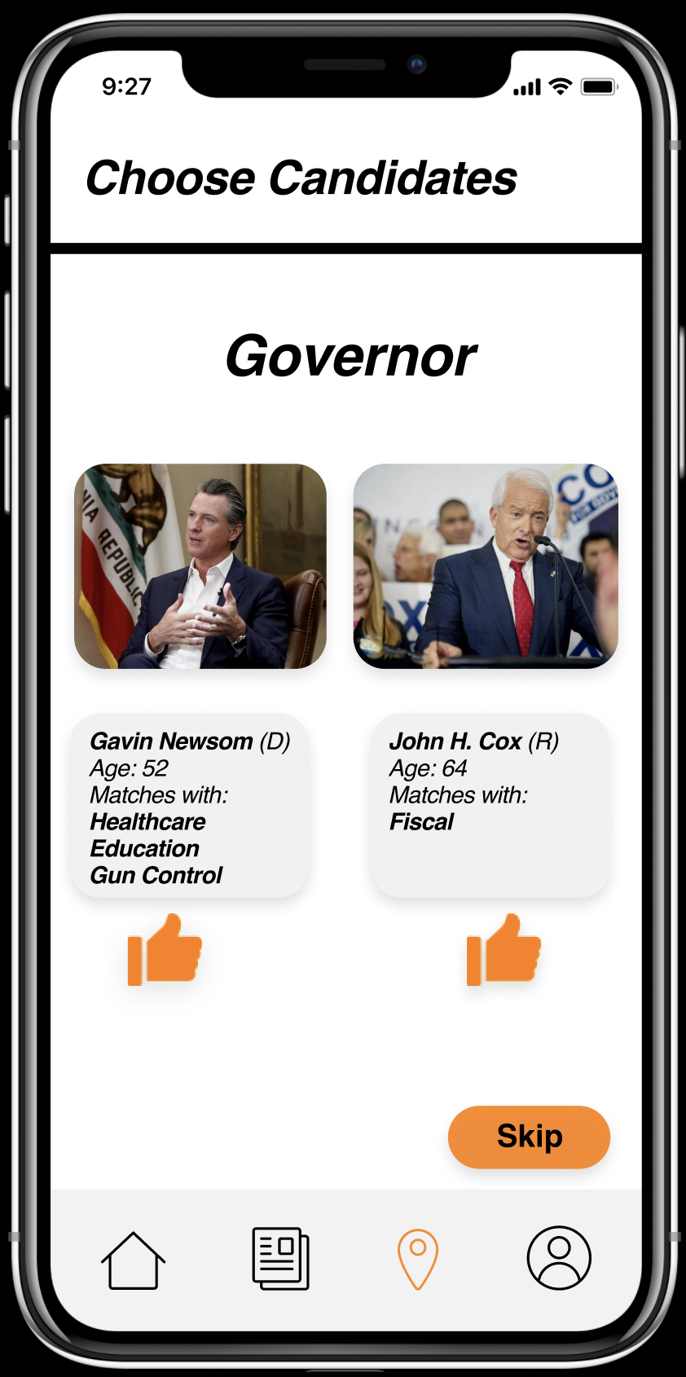
Major Design Change Two: Selecting Candidates
Realized that “swiping” to choose candidates and “swiping” to choose policies was potentially confusing users.
Decided to make candidate comparisons not “swipe-based”.
One candidate at a time with swiping
All candidates running with a like button

Slide 9
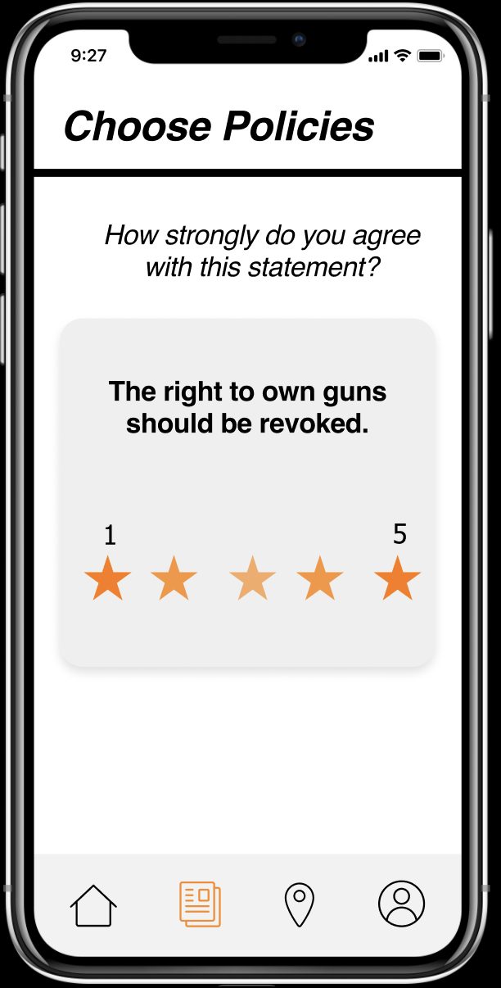
Major Design Change Three: Gauging Political Leaning
Initially we just had users swipe on policies that they were interested in. While this was useful, it did not provide nuanced enough information.
For each policy users swipe right on, we now have several follow-up questions to gauge their views on the topic (i.e. if they are for or against gun control).

Slide 10
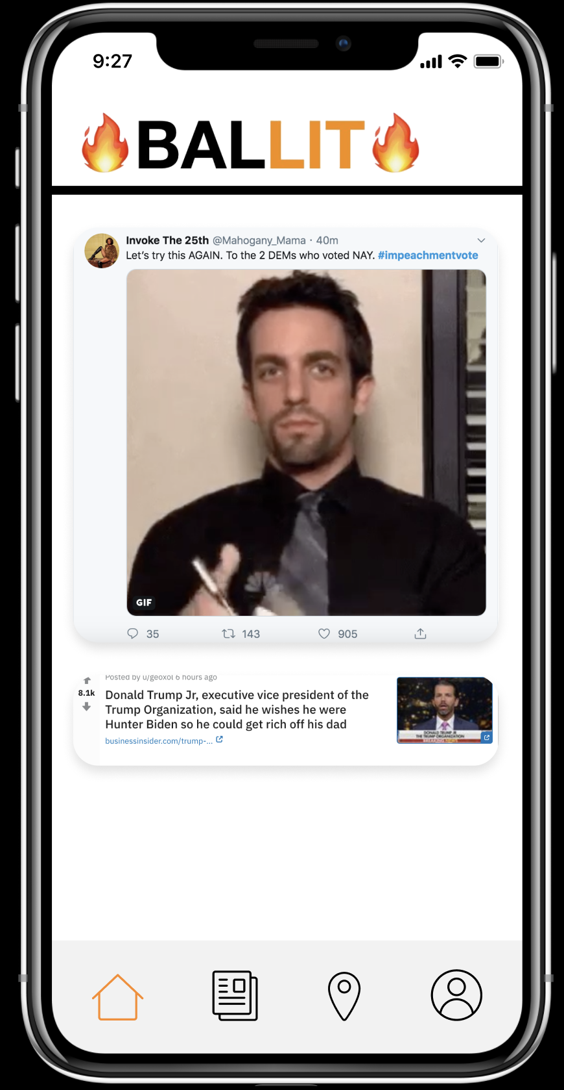
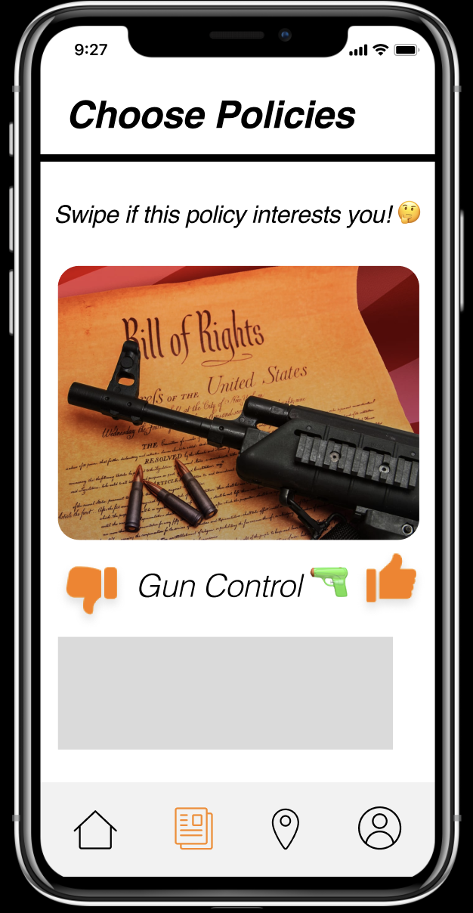
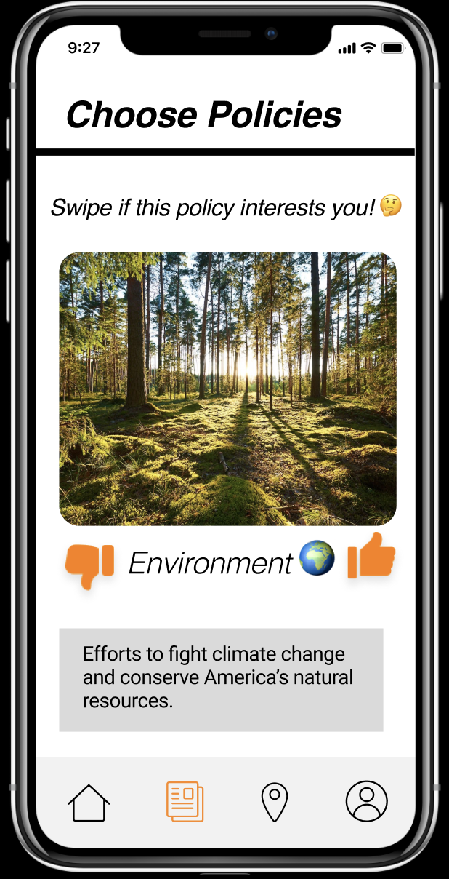
Task Flow One: Finding Policies
The laws regulating the manufacture and sale of firearms in the US.
Click to navigate to Policies tab
Learn more about a policy and then swipe.
Get presented with a new policy.
Select how you feel on an issue.

Slide 11
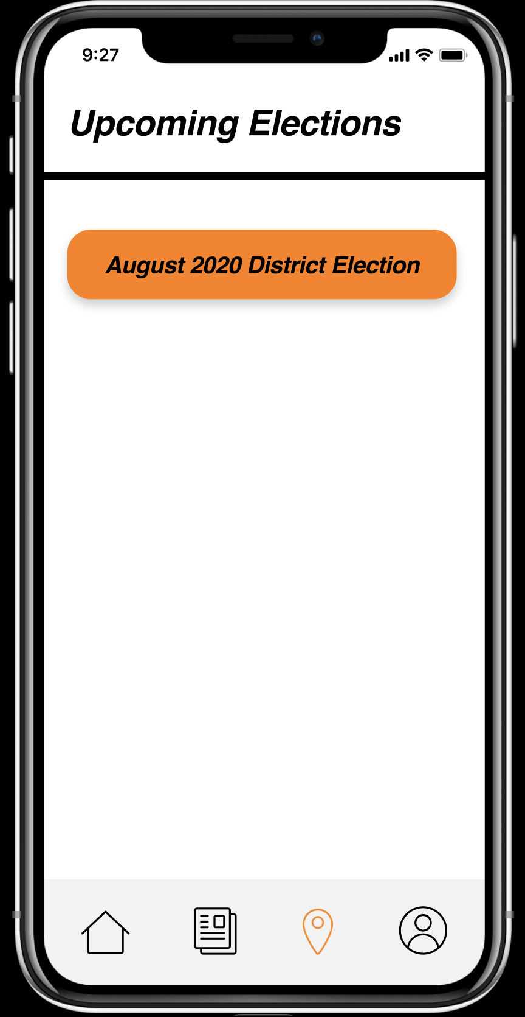
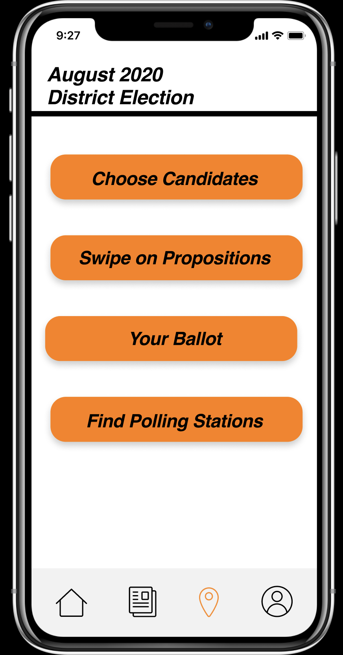
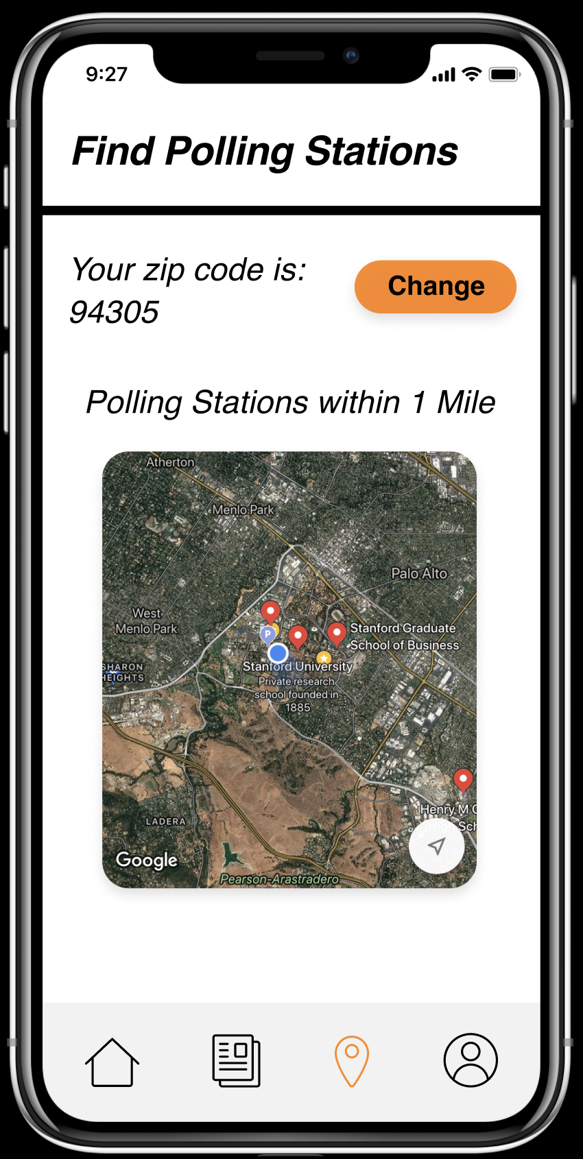
Task Flow Two: Upcoming Elections
Click to navigate to Elections tab
Click to learn more about specific upcoming election
Click to compare candidates
Receive directions to nearby polling stations

Slide 12
Task Flow Three: Picking Candidates
Click to navigate to Elections tab
Click to learn more about specific upcoming election
Click to compare candidates
Choose candidate of interest

Slide 13

Prototyping Tools
We utilized Figma to create our prototype.
Pros:
Allowed for simultaneous collaboration between team members
Low barrier to entry compared to InVision and Balsamiq
Cons:
Prototype with few interactive features
Limited functionality (i.e. not able to imitate “swiping” correctly)

Slide 14
Limitations and Tradeoffs of Prototype
Some task flows simplified
Only one potential path to “completion” of the task, optionality severely limited
No new social media content is being added to homepage
Not able to store user’s preference with policies
Key piece is being able to let users change their minds and access all of their choices in one centralized location

Slide 15
Hardcoding / Wizard of Oz
Social media posts:
Only one link, tweet, and TikTok
Current location and nearby polling stations are hardcoded because we don’t currently have access to polling station locations
Small subset of policies of interest:
Only environment and gun control
Only one election
August 2020 District Election

